Slide 1

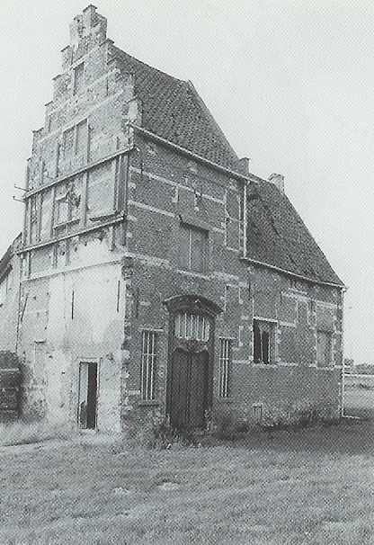




2h
SQL
Training
Hands-On
Intermediate
QA Event

Slide 2


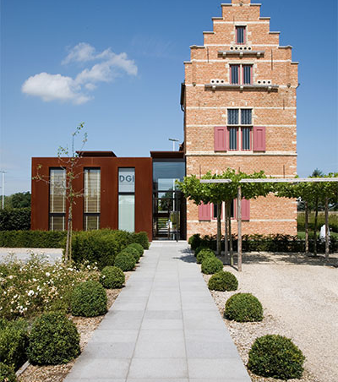

Menu
Intro
Gotchas
Exercises!

Slide 3



Intro
Score points by solving the exercises
Scoreboards
Most points
Solved fastest
Solved with shortest query
Extra point for ⭐ the repository ;)
Price for most points!
There are memes!
Dbs: Postgres & SQL Server

Slide 4
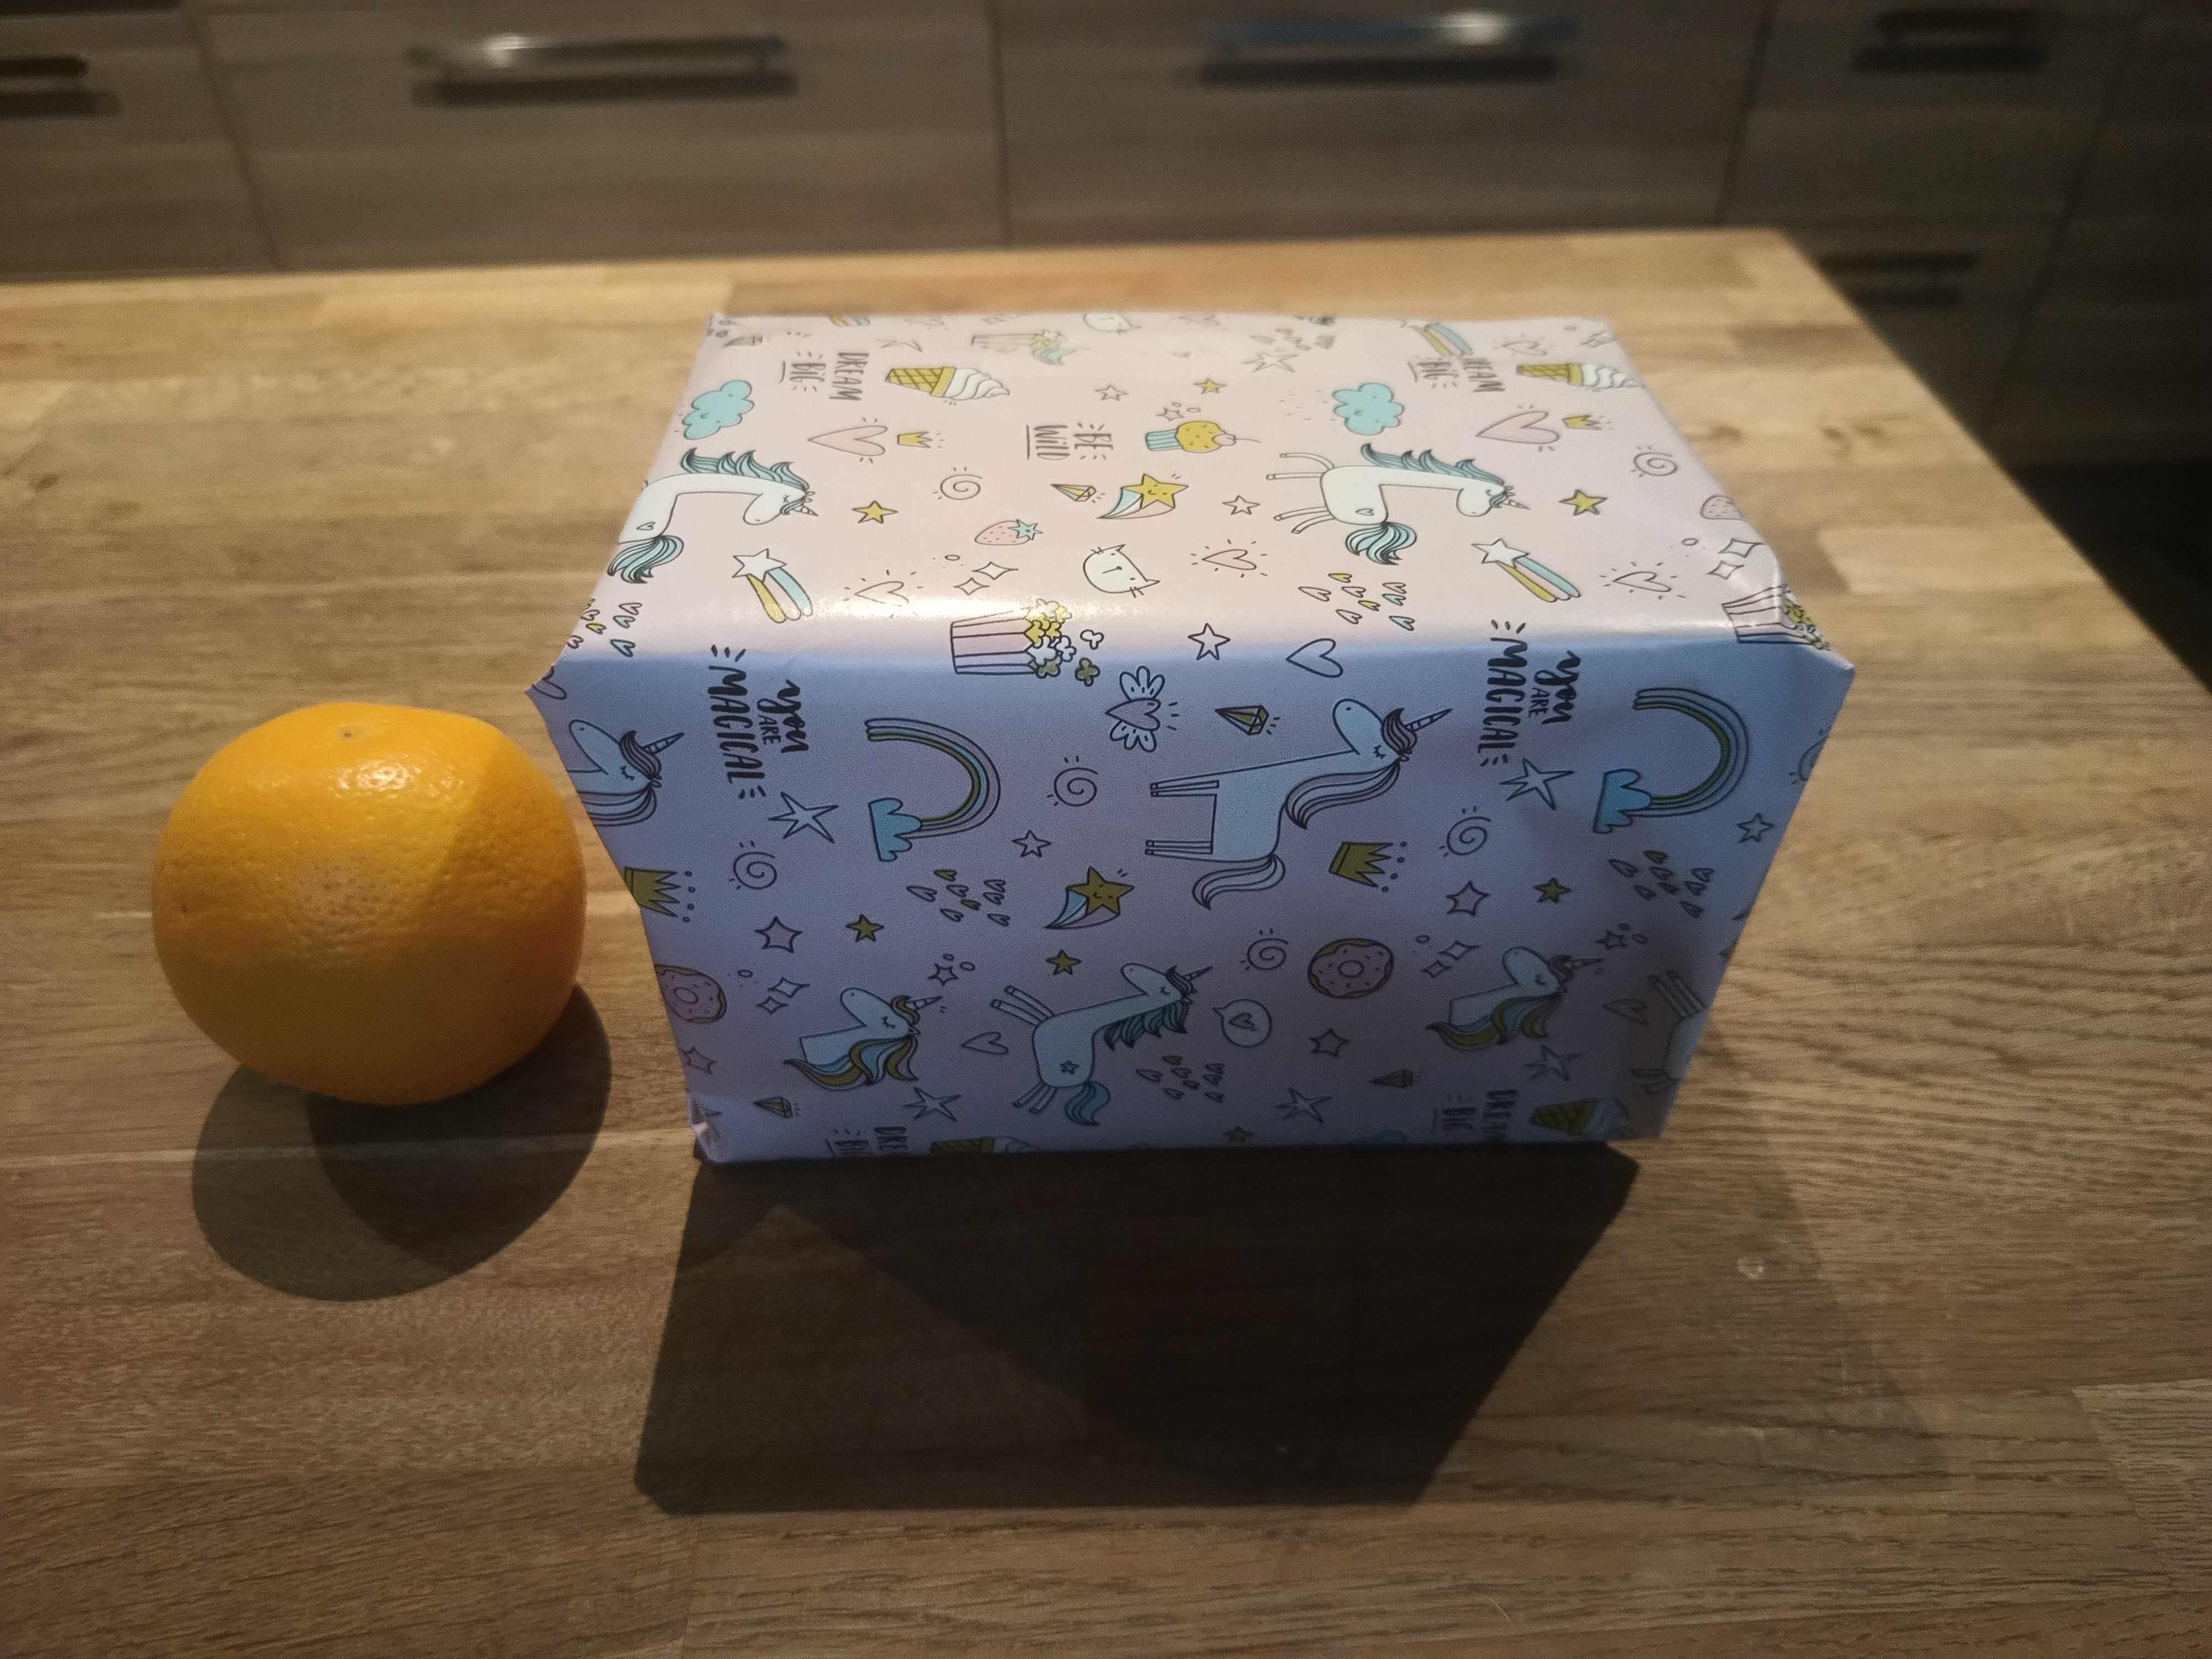
Le Prize
* Banana for scale

Slide 5
Gotchas
There is a swagger (for db structure)
Worldcup Schema!
Timer starts when first viewing the q
Column names issues
SELECT AVG(a), AVG(b)
See README for a db restore
Pick unique and recognizable name!
Submit a query to enable hint button
Your SQL is stored, no “cheating”
End game: see winning SQLs

Slide 6
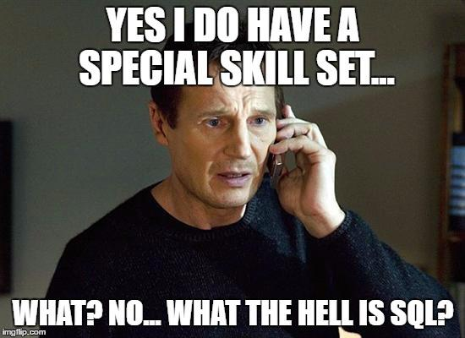

Slide 7



Exercises
Let’s get this party started!
git clone https://github.com/itenium-be/sql-training
cd sql-training
docker compose up -d --build
http://localhost:5173

Slide 8








Our Socials
@itenium
@itenium_be
itenium
itenium-be
itenium.be
@itenium
itenium.be

Slide 9




WiFi: ITENIUM_GAST / FreeWifi

Slide 10



THANK YOU!

